Slide 1
Enterprise-ready cloud
Notes:
Information in this document, including URL and other Internet Web site references, is subject to change without notice. Unless otherwise noted, the example companies, organizations, products, domain names, e-mail addresses, logos, people, places, and events depicted herein are fictitious, and no association with any real company, organization, product, domain name, e-mail address, logo, person, place or event is intended or should be inferred. Complying with all applicable copyright laws is the responsibility of the user. Without limiting the rights under copyright, no part of this document may be reproduced, stored in or introduced into a retrieval system, or transmitted in any form or by any means (electronic, mechanical, photocopying, recording, or otherwise), or for any purpose, without the express written permission of Microsoft Corporation.
Microsoft may have patents, patent applications, trademarks, copyrights, or other intellectual property rights covering subject matter in this document. Except as expressly provided in any written license agreement from Microsoft, the furnishing of this document does not give you any license to these patents, trademarks, copyrights, or other intellectual property.
The names of manufacturers, products, or URLs are provided for informational purposes only and Microsoft makes no representations and warranties, either expressed, implied, or statutory, regarding these manufacturers or the use of the products with any Microsoft technologies. The inclusion of a manufacturer or product does not imply endorsement of Microsoft of the manufacturer or product. Links may be provided to third party sites. Such sites are not under the control of Microsoft and Microsoft is not responsible for the contents of any linked site or any link contained in a linked site, or any changes or updates to such sites. Microsoft is not responsible for webcasting or any other form of transmission received from any linked site. Microsoft is providing these links to you only as a convenience, and the inclusion of any link does not imply endorsement of Microsoft of the site or the products contained therein.
© 2017 Microsoft Corporation. All rights reserved.
Microsoft and the trademarks listed at https://www.microsoft.com/en-us/legal/intellectualproperty/Trademarks/Usage/General.aspx are trademarks of the Microsoft group of companies. All other trademarks are property of their respective owners.

Slide 2
Abstract and learning objectives
Abstract
Create an Azure cloud governance plan to advise a manufacturing company of the features available in Azure. Discover features to bring governance to their Azure deployments, distributed administration, and allowance for secure remote connectivity and development work for their offshore developers.
Learning objectives
Attendees will be better able to design a governance plan to showcase the security and governance features of Azure and control costs. In addition,
Provide for cost tracking by business unit, environment, and project
Provide for a distributed administration model
Put a service catalog in place to prevent deployment of unsupported Azure services
Put controls in place to allow deployment of services only in specific regions

Slide 3
Step 1: Review the customer case study
Outcome
Analyze your customer needs
Timeframe
15 minutes

Slide 4
Customer situation
Trey Research
Consumer products manufacturing company
Annual revenues of USD $29.6 billion
Global company
Headquarters in New Jersey
Major offices in the UK, France, and Japan
Data centers and branch offices scattered across the United States
Looking to mitigate creeping costs as well as start the transition to a modern cloud enterprise architecture

Slide 5
Customer situation
Trey Research
Ken Greenwald, Trey Research’s CTO
Understands the value of the cloud
Concerned that the ease of creating resources may undermine technical and financial benefits of the cloud
Focus on best practices and governance
Notes:
Ken Greenwald, Trey Research’s CTO, is aware of the value of the cloud and it’s ability to spin-up services on-demand is not lost on him.
But Ken also has a keen understanding that with the ease of creating resources that Azure provides it also opens up the opportunity to start implementations incorrectly and allow these incorrect practices to disburse across the enterprise.
With this in mind, Ken wants to start off on the right foot by focusing on best practices from the start.

Slide 6
Customer situation
Trey Research enterprise IT responsibilities
Managing corporate networks
Data center distribution
Capacity planning
Identity
Enterprise wide SaaS services
Support for services and data centers
Hardware and services policies and auditing
Notes:
To kick off planning for integrating Azure into their environment, Ken introduced you to several directors within Trey Research’s Enterprise IT group that have been part of the initial Azure planning process.
Enterprise IT is responsible for managing corporate network connectivity, datacenter distribution, capacity planning, identity, and enterprise wide SaaS services for Trey Research employees. Enterprise IT is also responsible for supporting the services and datacenters, and setting auditing policy on hardware and services.

Slide 7
IT organization
Each business unit has its own IT resources and IT budget
Track and alert on costs by business unit, project and workload type
Delegate management to business unit IT
Trey Research
Industrial & Consumer
Electronics
Life Sciences
Product
Development
Marketing
Sales & Support
Product
Development
Marketing
Sales & Support
Product
Development
Marketing
Sales & Support
Regional (US/EU/Asia)
Regional (US/EU/Asia)
Regional (US/EU/Asia)
Notes:
Below is a partial view of Trey Research’s organization. Each rectangle represents a business unit and sub units within the business unit. Each of which has IT resources with an assigned budget/quota that will be able to consume Azure for related IT services.
Areas of concern: Tracking costs by business unit, project, and workload type, as well as delegating partial management of Azure

Slide 8
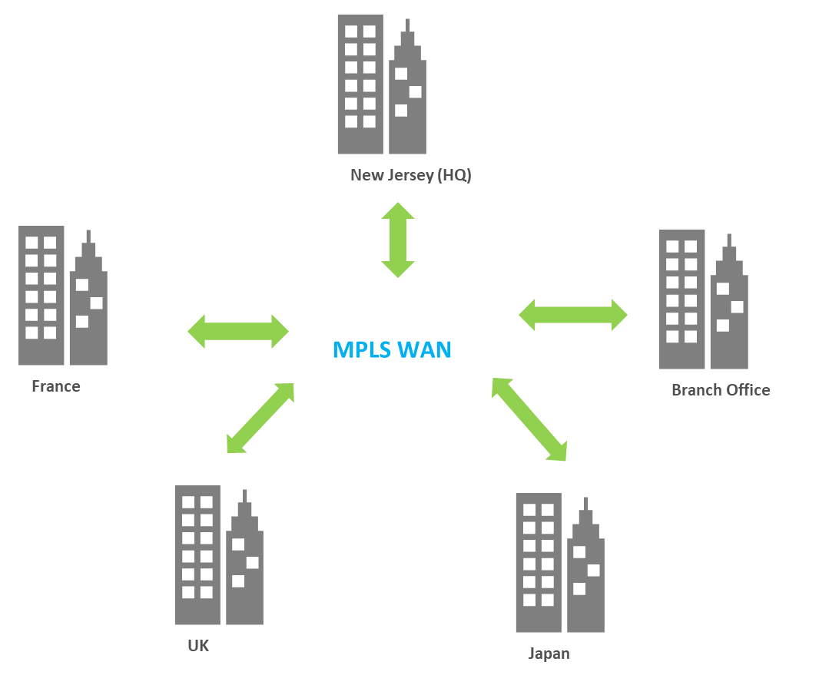
Trey Research current network architecture
Globally connected through an MPLS WAN
Branch offices connected via site-to-site VPN
All traffic in and out of each location is routed through a security appliance
Notes:
Globally connected through an MPLS wide area network.
Several branch offices are connected via site-to-site VPN.
All traffic in and out of each location is routed through a security appliance

Slide 9
Trey Research enterprise IT preliminary recommendations
Deploy critical applications across multiple regions
If cross-region architecture is not feasible, failback to on-premise
Supported Regions
Primary Region | Failover Region
East US | South Central US
West Europe | North Europe
Japan West | Japan East
Notes:
Critical Internet and intranet facing web based workloads
Typically use IIS and SQL Server
Some use Apache and MySQL.
Trey Research IT Recommendations to business units
Architect critical applications by deploying across multiple regions, or
If that type of architecture is not feasible to failback to on-premises.
List of preliminary Azure Regions to support
Primary: East US, Failover: South Central US
Primary: West Europe, Failover: North Europe
Primary: Japan West, Failover Japan East

Slide 10
Security and accident protection
Track all events leading to an issue
Identify users involved in an issue
Prevent accidental deletion of production resources
Ensure VMs meet Azure security best practices and are still protected if the security perimeter is breached

Slide 11
Corporate e-commerce website
Customers orders directly from Trey
Site and order fulfillment system hosted on Apache and Red Hat Enterprise Linux
Managed by the enterprise IT E-commerce team
Responsible for maintenance and development
Significant number of contingent staff
Delays in onboarding and environment provisioning
No secure remote solution
Need to increase agility and cut costs
Notes:
The e-commerce team is owned by the Enterprise IT team and is responsible for building and maintaining the corporate website where consumers and channel partners can order products directly from Trey Research. The e-commerce site and order fulfillment system is currently hosted on Apache and Red Hat Enterprise Linux.
Significant number of contingent staff
Delays in onboarding, hardware and environment provisioning
No secure remote solution so staff must be temporary located onsite for development
Need to increase agility and cut costs

Slide 12
Customer needs
Architecture
Identify a top level strategy for building geo-redundant solutions
Governance
Implement a change tracking solution
Recommend a process to prevent the accidental deletions of resources
Implement a chargeback solution
Apply governance to business units to control what can be created
Provide a cost management solution to the business units
Ensure a standardized naming convention for Azure resources
Governance management overhead must be implemented with minimum per-subscription overhead and changes must be auditable

Slide 13
Customer needs
Networking
Identify connectivity requirements with ExpressRoute access control and availability
Security
Provide access to create and manage new workloads in Azure for various business units
Implement delegated access control for new projects within the business unit subscription
E-commerce Team
Provide access to needed resources for contingent staff for the e-commerce team
Increase agility to speed up the onboarding of contingent resources
Secure remote access for the e-commerce team

Slide 14
Customer objections
We need the ability to split out our Azure bill by business unit and even workload classification. Can Azure do it? How can we analyze our bill for cost optimization and charge back?
As well as implementing our governance rules on how Azure is used, we need a way to audit that no deployments have been made that bypass those roles.
Security is important to us. We have evaluated Network Security Groups and our security team does not feel they offer the same level of security that we use with our on-premises firewall based solutions such as intrusion and malware detection.

Slide 15
Customer objections
Delegating control to business units is incredibly important to Trey Research. At our scale a single team cannot possibly manage all of the needs of the business. That being said, corporate IT does require the ability to set policy at the enterprise level and still needs a detailed level of control. How can Azure address these needs?

Slide 16
Customer objections
Trey Research currently monitors their on-premises workloads using SCOM. A small business unit experimented with running virtual machines in AWS and the monitoring team was not thrilled with a completely different system for monitoring for availability. Does Azure have the same problem?

Slide 17
Customer objections
How can we ensure our deployments meet Azure security best practices, and how can we protect our Production workloads even in the event that the security perimeter is compromised?
How can Azure help control the costs associated with non-Production VMs left running out-of-hours?

Slide 18
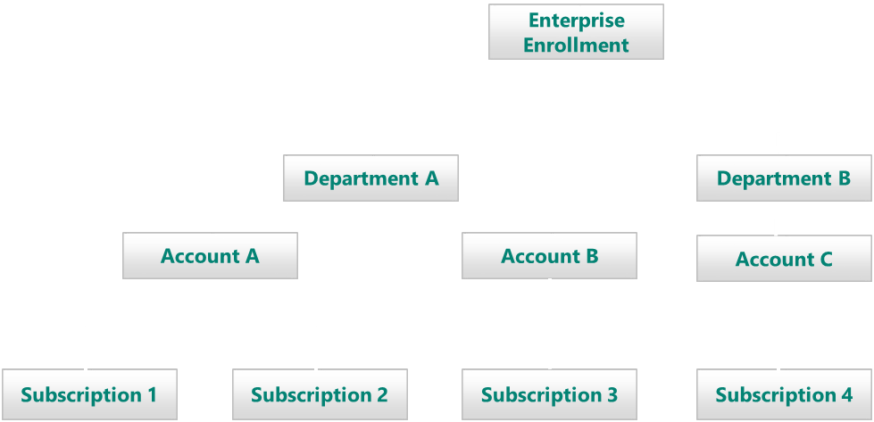
Common scenarios
Azure EA portal
Manage access to Azure EA enrollments
Organize and delegate access to subscriptions
View usage
http://ea.azure.com

Slide 19
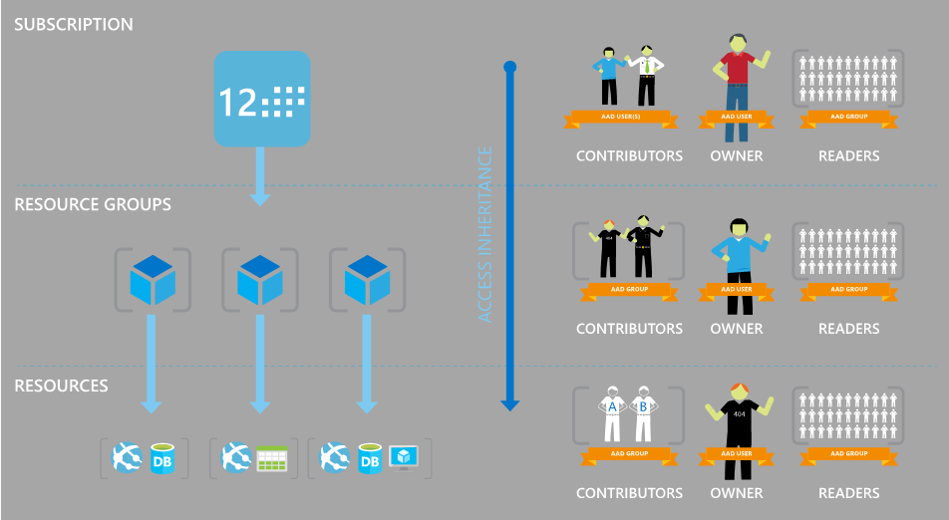

Common scenarios
Role-based access control (RBAC) and ARM policies
Governance of Azure resources
Granular access control

Slide 20
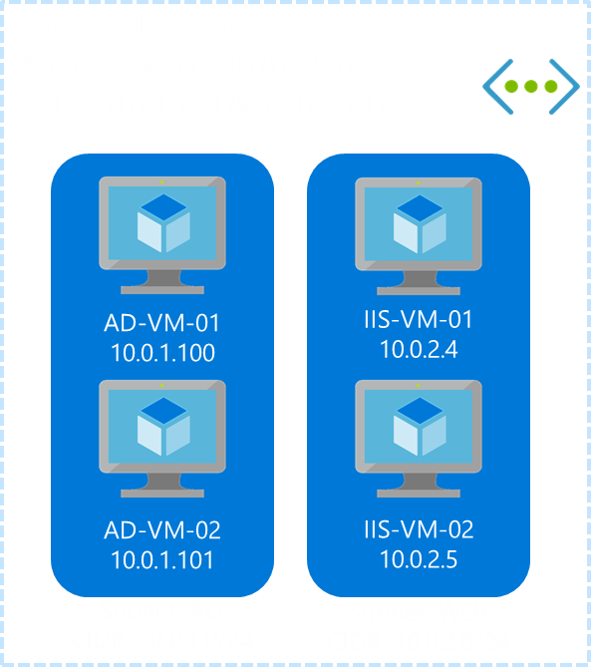


Common scenarios
Infrastructure as a Service
Virtual machines
Virtual networks
Hybrid networking
Site-to-site
Point-to-site
ExpressRoute
ExpressRoute

Slide 21
Step 2: Design the solution
Outcome
Design a solution and prepare to present the solution to the target customer audience in a 15-minute chalk-talk format.
Timeframe
60 minutes
Business needs (10 minutes) | Respond to questions outlined in your guide and list the answers on a flipchart.
Design (35 minutes) | Design a solution for as many of the stated requirements as time allows. Show the solution on a flipchart.
Prepare (15 minutes) | Identify any customer needs that are not addressed with the proposed solution. Identify the benefits of your solution. Determine how you will respond to the customer’s objections. Prepare for a 15-minute presentation to the customer.

Slide 22
Step 3: Present the solution
Outcome
Prepare to present a solution to the target customer in a 15-minute chalk-talk format
Timeframe
30 minutes (15 minutes for each team to present and receive feedback)
Directions
Pair with another table
One table is the Microsoft team and the other table is the customer
The Microsoft team presents their proposed solution to the customer
The customer asks one of the objections from the list of objections in the case study
The Microsoft team responds to the objection
The customer team gives feedback to the Microsoft team

Slide 23
Wrap-up
Outcome
Identify the preferred solution for the case study
Identify solutions designed by other teams
Timeframe
15 minutes

Slide 24
Preferred target audience
Ken Greenwald, CTO
Enterprise IT Directors
Business Unit technical leads within Enterprise IT
EA Portal Administrators

Slide 25
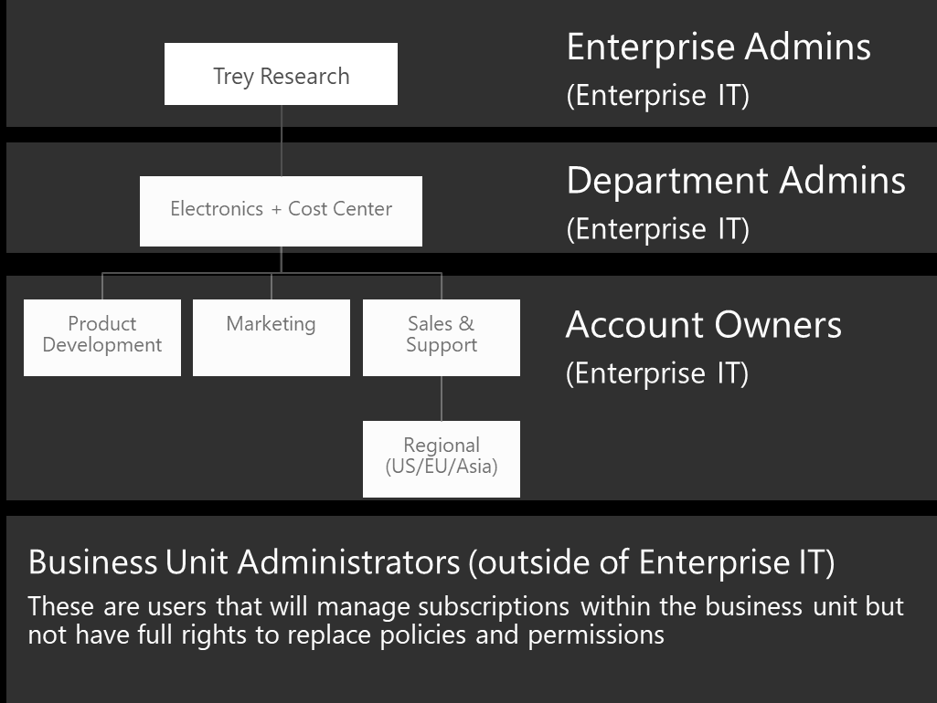
Preferred solution - subscription organization
Enterprise IT manages all subscriptions
Departments associated to cost center at creation time
Enterprise admins would grant department admins right to view usage
Department admins would add account owners to create and manage subscriptions

Slide 26
Preferred solution - delegating access control
Business unit admins access control
Create Azure AD group for each business unit
Add business unit admins to group
Add the Azure AD group to contributor role
Use RBAC to assign permissions with management groups for cross subscription management
Leverage ARM templates to deploy per corporate standards
Azure AD B2B collaboration to allow access from partner managed identities
Notes:
Create a group in Azure AD for that business unit “BU1-Azure-Managers” for example and add those users to the group. Within the Azure subscription, add the Azure AD group to the contributor role.
Contributors do not have permissions to add or remove users or change policies.
Using RBAC to assign permissions to users and groups
Using ARM templates, we can restrict various items like locations using allowed values to limit choices available.
Using Azure Active Directory B2B collaboration we can allow access to corporate applications from partner-managed identities.

Slide 27
Preferred solution - elevated access
Business unit admins elevated access
Elevated access will require Enterprise IT to add the business unit admins group to the owner role
$rgName = "BUProjectName"
$region = "West US"
$userToAdd = "[user from AD]"
$rg = New-AzureRmResourceGroup -Name $rgName -Location $region
New-AzureRmRoleAssignment -ResourceGroupName $resourceGroup `
-RoleDefinitionName "Owner" `
-SignInName $userToAdd
Notes:
Create a group in Azure AD for that business unit “BU1-Azure-Managers” for example and add those users to the group. Within the Azure subscription, add the Azure AD group to the contributor role.
Contributors do not have permissions to add or remove users or change policies.
Using RBAC to assign permissions to users and groups
Using ARM templates, we can restrict various items like locations using allowed values to limit choices available.
Using Azure Active Directory B2B collaboration we can allow access to corporate applications from partner-managed identities.

Slide 28
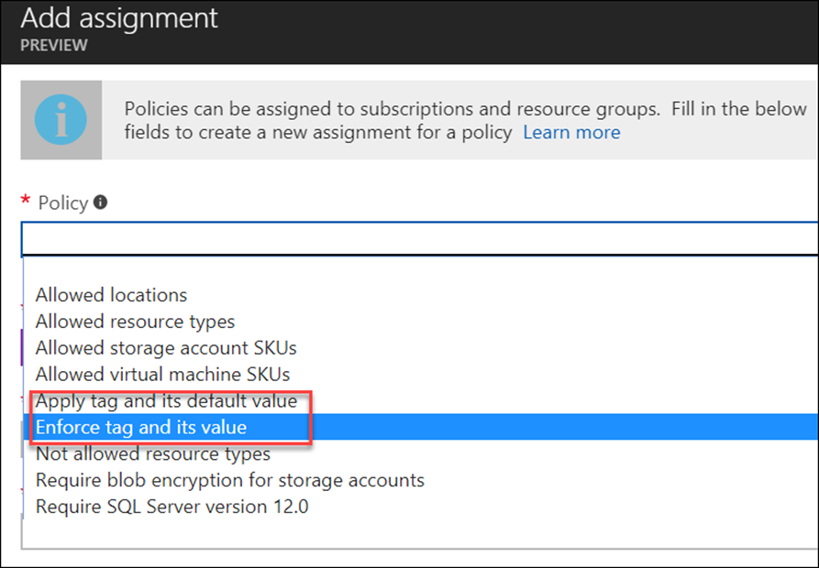
Preferred solution - tracking usage
Enforcing tags to track usage
Create one resource group per environment
Assign policy requiring tags upon creation
Tag name: environment
Values: development, test, production, infrastructure, support services, etc.
Notes:
Enforcing tags at the business unit for usage taxonomy
Create a resource group per environment (Test, Prod, etc.) and assign builtin policies that require all resources to apply a tag upon creation
Tag Name: Environment – Value: Development and Test
Tag Name: Environment – Value: Production
Tag Name: Environment – Value: Support Services
Tag Name: Environment – Value: Infrastructure

Slide 29
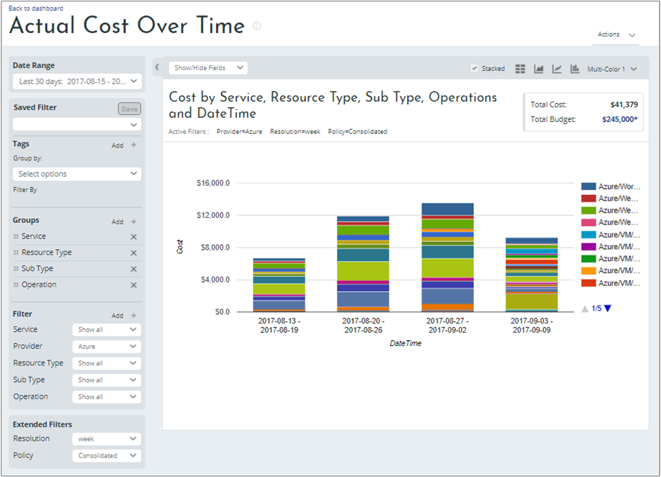
Preferred solution - tracking usage
Cost management
Register for Azure Cost Management by Cloudyn
Create hierarchy of cost entities in Cloudyn
Choose appropriate access levels for each subscription in your EA
Assign each subscription to a cost entity
Create users for business units and the finance department
Notes:
Enforcing tags at the business unit for usage taxonomy
Create a resource group per environment (Test, Prod, etc.) and assign builtin policies that require all resources to apply a tag upon creation
Tag Name: Environment – Value: Development and Test
Tag Name: Environment – Value: Production
Tag Name: Environment – Value: Support Services
Tag Name: Environment – Value: Infrastructure

Slide 30
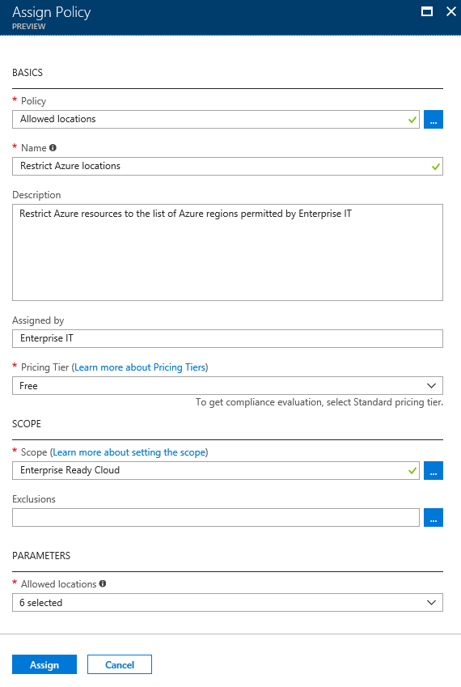
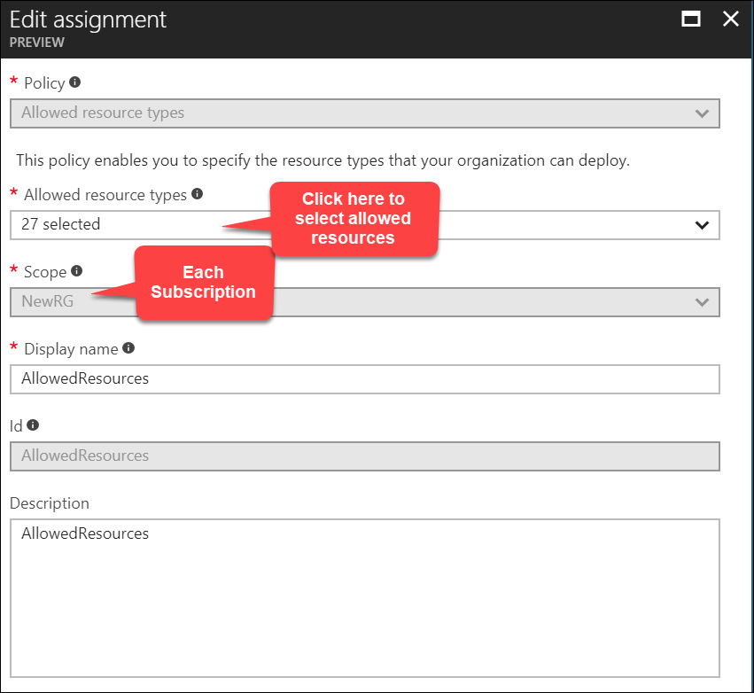
Preferred solution - restricting supported services and regions
Built-in policies
Allowed resource types
Limit access to supported services with ARM policies
Allowed locations
Limit access to specific regions
Notes:
To address the requirement of restricted services and regions use the built in policies Allowed resource types and Allowed locations

Slide 31

Preferred solution - ExpressRoute
Built-in policy
Not allowed resource types
Notes:
An additional policy would need to be created and applied to allow users to not create ExpressRoute circuits but still use them by linking their virtual networks.
This policy is specific to the write action of the expressRouteCircuits resource type.

Slide 32
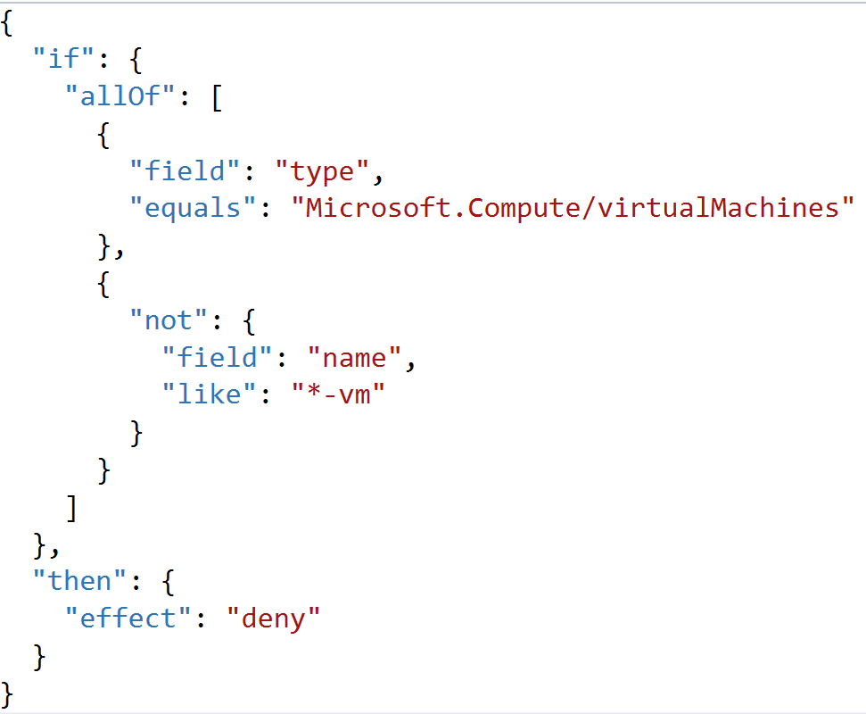
Preferred solution - enforcing naming convention
Create policies using the name field by resource type
Assign via a policy initiative
Grouping policies per resource type
Notes:
The above example shows how to enforce a simple naming constraint on a single resource type—virtual machines. Enterprise IT need to enforce their convention across all their resource types. Implementing this in a single policy requires an impractically-large conditional logic in the policy rule.
Instead, separate policies should be created for each resource type. These policies should then be combined into a single policy initiative. Using a policy initiative allows the entire set of policies to be assigned in a single operation. It also allows new naming rules to be added easily—simply add the new rule to the initiative and it will be applied across all existing assignments.

Slide 33
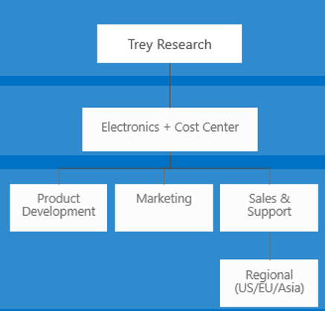

Preferred solution - minimize subscription management overhead
Group subscriptions into a management group
Apply policies at the appropriate level for inheritance
Use Exception path for ExpressRoute policy to permit Enterprise IT usage
Use standard policy tier to generate compliance reports
Management Group with policy naming C=convention
Notes:
Solution: To minimize subscription-level configuration, subscriptions should be grouped into a management group hierarchy, managed by Enterprise IT. This hierarchy should reflect the business unit structure.
Enterprise IT should then apply Azure policies used for governance at the appropriate management group level. For example, since the naming convention policy initiative is to be used company wide, it need only be applied once, at the tenant root management group. It will then be inherited by all subscriptions in the organization, including new subscriptions, without any per-subscription configuration.
Using the Standard policy tier enables Azure to generate a compliance report, showing which resources in the scope of a given policy are out of compliance (do not meet the policy rule condition) of the policy.
In the case of the naming convention policy, since this is applied at the root tenant management group level, this allows Enterprise IT to easily see which resources are not following the naming convention, company-wide.
In the case of the policy to enforce Environment tags, the policy discussed earlier uses different tag values for different projects, hence the policy is not applied at the root tenant management group level, but instead at the level of individual subscriptions or resource groups. A separate policy should be created to verify that the Environment tag is in place and uses one of the permitted values. This policy can be applied at the root tenant management group level. This will both enforce that all resources in all subscriptions include the Environment (even if a project-level rule is forgotten), and also provide a single compliance audit report. An

Slide 34



Preferred solution - minimize wasted spend on non-prod VMs
Azure DevTest Labs
Configure automatic start/stop time
Start/Ssop VMs during off-hours solution starts and stops
Azure Cost Management (by Cloudyn)
Notes:
For Dev/Test scenarios, Azure Dev/Test Labs enables the full lifecycle of Dev/Test environments to be managed, including hours of use, and policies on the number and size of VMs per user and per lab.
Each VM can be configured with a time at which it will automatically shut down until restarted. This is available in the management portal when creating the VM, or afterwards. This feature was originally part of Dev/Test Labs and is now available for all VMs.
The ‘Start/Stop VMs during off-hours’ offering in the Azure Marketplace also offers the ability to automatically configure when VMs will run. This solution has the advantage that a single configuration can be applied across a subscription (selectively if necessary), rather than being applied to each individual VMs. It also has the ability to schedule VM start time as well as stop time. It could potentially be extended to auto-shutdown VMs based on their Environment tag.
Azure Cost Management (by Cloudyn) offers reports showing VM utilization and recommendations for stopping idle VMs and right-sizing under-utilized VMs.

Slide 35
Preferred solution - sharing an ExpressRoute circuit
Enterprise IT creates the circuit and generates an authorization key
$circuit = Get-AzureRmExpressRouteCircuit -Name "MyCircuit" `
-ResourceGroupName "MyRG"
Add-AzureRmExpressRouteCircuitAuthorization -ExpressRouteCircuit $circuit `
-Name "MyAuthorization1"
Set-AzureRmExpressRouteCircuit -ExpressRouteCircuit $circuit
Get-AzureRmExpressRouteCircuitAuthorization -ExpressRouteCircuit $circuit `
-Name "MyAuthorization1"
Admins in subscription create virtual networks using key to link the circuit
$connection = New-AzureRmVirtualNetworkGatewayConnection -Name "ercon" `
-ResourceGroupName $rg `
-Location $region `
-VirtualNetworkGateway1 $gw `
-PeerId $id `
-ConnectionType ExpressRoute `
-AuthorizationKey $authKey
Notes:
An additional policy would need to be created and applied to allow users to not create ExpressRoute circuits but still use them by linking their virtual networks.
This policy is specific to the write action of the expressRouteCircuits resource type.

Slide 36

Preferred solution - chargeback
Built-in policy
Apply tag and its default value
Apply to all resource groups specific to project
Compliance report: use custom policy checking tag name (not value) at tenant root management group using standard SKU
Notes:
To track costs by project, a new ARM policy should be applied to all resource groups specific to the project. The policy should automatically append an ioCode tag to all resources. Costs will be grouped by the tag applied and chargeback costs can be calculated later.
To check the tag is always in place, create a separate policy, action ‘audit’, that just checks that the tag name is used. Apply at the tenant root management group using the standard SKU to enable a policy compliance report company-wide

Slide 37

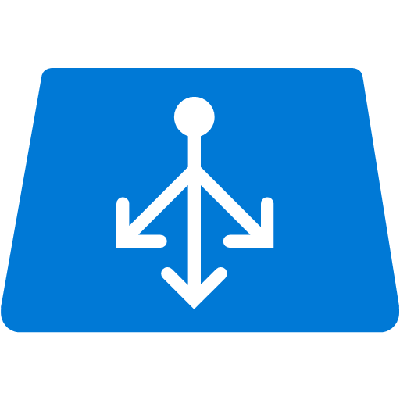
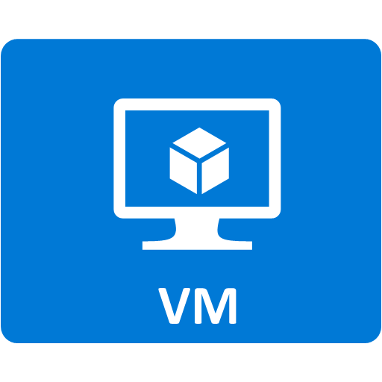
Preferred solution - geo-redundant solutions
Traffic Manager
priority mode
Use paired regions
Physical isolation
Platform provided replication
Region recovery order
Sequential updates
Data residency
Use traffic manager
Was not part of initial service list
Requires a public endpoint
Private workloads would need modifications
West US
East US
Web Tier
Web Tier
Availability Set
Availability Set
SQL AO
Secondary
SQL AO
Primary
Availability Set
Paired Regions
Notes:
Instead of deploying in South Central US and East US, Trey Research should use East and West US because they are paired regions.
Paired region benefits:
Physical isolation
Platform provided replication
Region recovery order
Sequential updates
Data residency
For geo-redundant solutions, Traffic Manager should be considered (not part of the initial service list in policy)
Traffic Manager can only test and return public endpoints for traffic distribution.
Public workloads as-is
Private workloads—would need to be adapted to listen on a public IP with traffic locked down or use another solution for internal DNS updates.

Slide 38
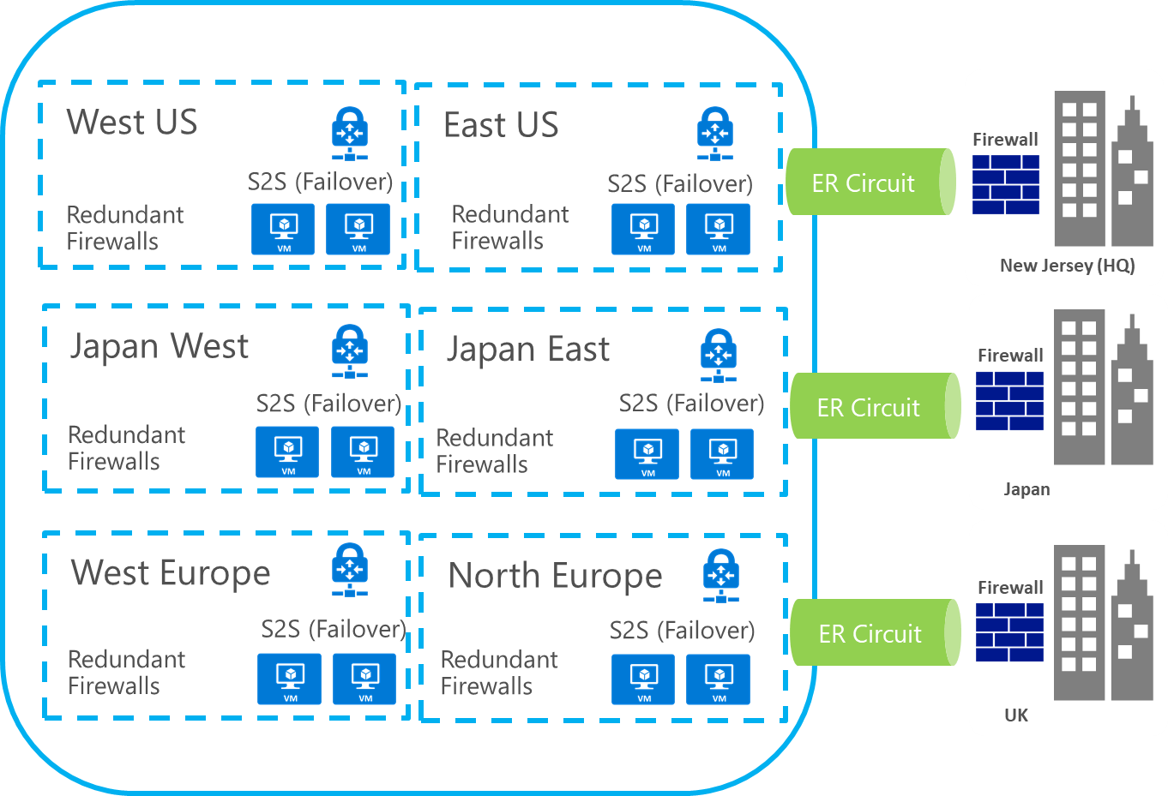
Preferred solution - high-level connectivity plan
User defined routes
Route traffic through virtual appliance firewalls
ExpressRoute & VPN
Firewall on on-prem side of the circuit
VNets joined to the same routing domain using ExpressRoute Premium
Use site-to-site VPN to connect branch offices that are not on the WAN
Redundancy provided by site-to-site VPN
Notes:
User defined routes route traffic in and out of the virtual network through virtual appliance firewalls
Firewall and intrusion detection on the on-premises side of the circuit
Virtual networks joined to the same routing domain (globally) using the ExpressRoute Premium SKU
Site-to-Site VPN could be used to connect sites not connected to the WAN and provide redundant connections from on-premises to the virtual networks in the event of an outage with ExpressRoute

Slide 39
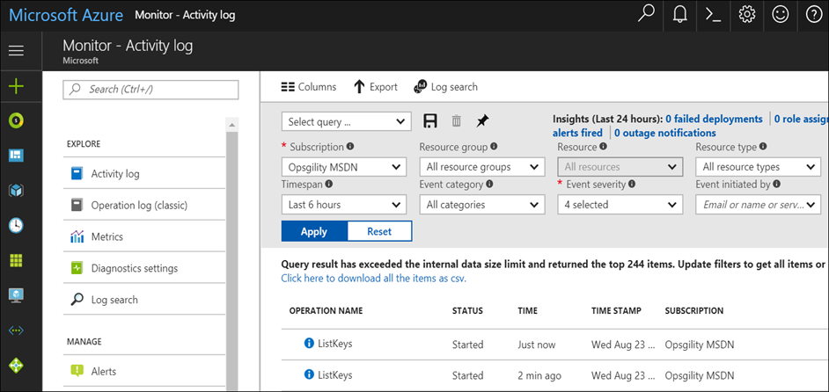

Preferred solution- security and accident protection
Azure Resource Manager locks
CanNotDelete
ReadOnly
Subscription Audit Logs
Identify user who deleted the resource
Azure Security Center
Configure security policies centrally
Standard SKU allows adaptive application controls such as whitelisting applications
Notes:
Use Azure Resource Manager locks to add a secondary layer of protection on production workloads. Locks can set in two modes:
CanNotDelete
ReadOnly
Locks can be set programmatically or through the portal.
To identify who deleted the resource, looking at the Audit Logs for the subscription
Design: How can we ensure our deployments meet Azure security best practices, and how can we protect our Production workloads even in the event that the security perimeter is compromised?
Solution: Use Azure Security Center to help secure VMs. In particular:
Azure Security Center allows you to centrally configure policy settings to define the security requirements of your organization. It then performs continuous security assessment of all VMs against that security policy, and provides actionable recommendations to remediate security vulnerabilities.
Using the Standard SKU of Azure Security Center in addition allows you to enable adaptive application controls. These provide a means to block attempts to run malicious applications by maintaining whitelists of permitted executables. This feature can be applied selectively, for example only to Production and Pre-Production resource groups.

Slide 40
Preferred solution - E-Commerce team
Providing secure access to contingent staff
Create multiple DevTest Lab environments
Create preconfigured image for dev environments
Supported OS and common tools
Artifacts for specific dev teams
Configure DevTestLabs to have access to dev subnet
Use Network Security Group to restrict outbound traffic
Create a user in the DevTestLabs User role for the lab environment
Use point-to-site and Network Security Groups to control network access
Notes:
Use Azure Resource Manager locks to add a secondary layer of protection on production workloads. Locks can set in two modes:
CanNotDelete
ReadOnly
Locks can be set programmatically or through the portal.
To identify who deleted the resource, looking at the Audit Logs for the subscription

Slide 41
Preferred objections handling
Objection
We need the ability to split out our Azure bill by business unit, per project tracking, and even workload classification. Can Azure do it? How can we analyze our bill for cost optimization and charge back?
Potential answer
The Azure EA Portal allows a company to split their Azure usage up by departments (business units) and view consumption information at that level.
For per-project tracking, an ARM policy can automatically append an IO code to all resources created for the project. The Azure bill can roll up costs by the IO code.
Tags can also be used to associate a resource with a workload classification (like testing, production, or however they want to classify).
Reporting alerting can also be provided by Azure Cost Management by Cloudyn.
Notes:
Objection
We need the ability to split out our Azure bill by business unit, per project tracking, and even workload classification. Can Azure do it? How can we analyze our bill for cost optimization and charge back?
Potential answer
The Azure EA Portal allows a company to split their Azure usage up by departments (business units) and view consumption information at that level.
For per-project tracking, an ARM policy can automatically append an IO code to all resources created for the project. The Azure bill can roll up costs by the IO code.
Tags can also be used to associate a resource with a workload classification (like testing, production, or however they want to classify).

Slide 42
Preferred objections handling
Objection
As well as implementing our governance rules on how Azure is used, we need a way to audit that no deployments have been made that bypass those roles.
Potential answer
Implement governance rules using Azure Policy, and assign those Policies at the root tenant management group scope using the ‘Standard’ Azure Policy pricing tier. This ensures the policy is applied across all subscriptions within the organization, and enables an organization-wide compliance report.
Notes:
Objection: As well as implementing our governance rules on how Azure is used, we need a way to audit that no deployments have been made that bypass those roles.
Answer: Implement governance rules using Azure Policy, and assign those Policies at the root tenant management group scope using the ‘Standard’ Azure Policy pricing tier. This ensures the policy is applied across all subscriptions within the organization, and enables an organization-wide compliance report.

Slide 43
Preferred objections handling
Objection
Security is important to us. We have evaluated Network Security Groups and our security team does not feel they offer the same level of security that we use with out on-premises firewall based solutions such as intrusion and malware detection.
Potential answer
There are many third-party advanced firewall solutions available through the Azure Marketplace. Many support a bring your own license (BYOL) model where existing customers can reuse their licenses in Azure. They also support a pay-as-you go model for customers that want to pay as they use the product.
Notes:
Objection
Security is important to us. We have evaluated Network Security Groups and our security team does not feel they offer the same level of security that we use with out on-premises firewall based solutions such as intrusion and malware detection.
Potential answer
There are many third-party advanced firewall solutions available through the Azure Marketplace. Many support a bring your own license (BYOL) model where existing customers can reuse their licenses in Azure. They also support a pay-as-you go model for customers that want to pay as they use the product.

Slide 44
Preferred objections handling
Objection
Delegating control to business units is incredibly important to Trey Research. At our scale a single team cannot possibly manage all of the needs of the business. That being said corporate IT does require the ability to set policy at the enterprise level and still needs a detailed level of control. How can Azure address these needs?
Potential answer
At the enterprise level, IT can set policies and add users and groups as a subscription is created so when the subscription is handed off to the teams within each business unit they are setup per IT specs.
With role based access control, IT can allow access at varying levels for the business units, whether it is just allowing contingent developers access to a development environment, or it is allowing administrators full access to a subscription (excluding changing policy and access controls).
Notes:
Objection
Delegating control to business units is incredibly important to Trey Research. At our scale a single team cannot possibly manage all of the needs of the business. That being said corporate IT does require the ability to set policy at the enterprise level and still needs a detailed level of control. How can Azure address these needs?
Potential answer
At the enterprise level, IT can set policies and add users and groups as a subscription is created so when the subscription is handed off to the teams within each business unit they are setup per IT specs.
With role based access control, IT can allow access at varying levels for the business units, whether it is just allowing contingent developers access to a development environment, or it is allowing administrators full access to a subscription (excluding changing policy and access controls).

Slide 45
Preferred objections handling
Objection
Trey Research currently monitors their on-premises workloads using SCOM. A small business unit experimented with running virtual machines in AWS awhile back and the monitoring team wasn’t thrilled with a completely different system for monitoring for availability. Does Azure have the same problem?
Potential answer
There are multiple potential solutions to this problem. First, the virtual machines in Azure could be monitored the same way using the SCOM agent. Data would flow over the ExpressRoute connection. Another option would be to explore using Azure Log Analytics. This model would allow you to monitor servers on-premises and in Azure, and any VMs in another cloud (like AWS). When using Log Analytics for on-premises VMs or VMs in other clouds, the Log Analytics agent would need to be installed on the VMs being monitored.
Notes:
Objection
Trey Research currently monitors their on-premises workloads using SCOM. A small business unit experimented with running virtual machines in AWS awhile back and the monitoring team wasn’t thrilled with a completely different system for monitoring for availability. Does Azure have the same problem?
Potential answer
There are multiple potential solutions to this problem. First, the virtual machines in Azure could be monitored the same way using the SCOM agent. Data would flow over the ExpressRoute connection. Another option would be to explore using Azure Log Analytics. This model would allow you to monitor servers on-premises and in Azure, and any VMs in another cloud (like AWS). When using Log Analytics for on-premises VMs or VMs in other clouds, the Log Analytics agent would need to be installed on the VMs being monitored.

Slide 46
Preferred objections handling
Objection
How can we ensure our deployments meet Azure security best practices, and how can we protect our Production workloads even in the event that the security perimeter is compromised?
Potential answer
Azure Security Center allows you to define your VM security policy, monitor compliance, and receive actionable recommendations on how to implement Azure security best practices. Adaptive Application Controls, available in the Azure Security Center Standard pricing tier, enable you to control whitelists of which executables can run in your Production environments.
Notes:
Objection: How can we ensure our deployments meet Azure security best practices, and how can we protect our Production workloads even in the event that the security perimeter is compromised?
Answer: Azure Security Center allows you to define your VM security policy, monitor compliance, and receive actionable recommendations on how to implement Azure security best practices. Adaptive Application Controls, available in the Azure Security Center Standard pricing tier, enable you to control whitelists of which executables can run in your Production environments.

Slide 47
Preferred objections handling
Objection
How can Azure help control the costs associated with non-Production VMs left running out-of-hours?
Potential answer
DevTest labs, auto-VM shutdown, and the start-stop VM marketplace solution, all offer the ability to automatically shut down VMs. Azure Cost Management (by Cloudyn) provides additional reports to identify idle VMs and to right-size underutilized VMs.
Notes:
Objection: How can Azure help control the costs associated with non-Production VMs left running out-of-hours?
Answer: DevTest labs, auto-VM shutdown, and the start-stop VM marketplace solution, all offer the ability to automatically shut down VMs. Azure Cost Management (by Cloudyn) provides additional reports to identify idle VMs and to right-size underutilized VMs.

Slide 48
Customer quote
“The governance controls Azure provides allows Trey Research to move forward with a modern enterprise cloud environment knowing that IT still is in control but allows flexibility for our business units to do their job without us in the way.”
—Ken Greenwald CTO

